Slide 1

4 Keys of Fun for Racing Games
The racing type game genre gets the player to control the movement of vehicles to help avoid, collect and win an race. This results in the player acquiring rewards like in game currency, upgrades and all new vehicles.
These games have an element of strategy and reaching an goal causing the player to feel the emotions linked with Hard Fun.
Also these games tend to have an Mulitplayer or the ability for two players to play on one screen. This links to the player/s competing or co-operating which the emotions link to People Fun.

Slide 2
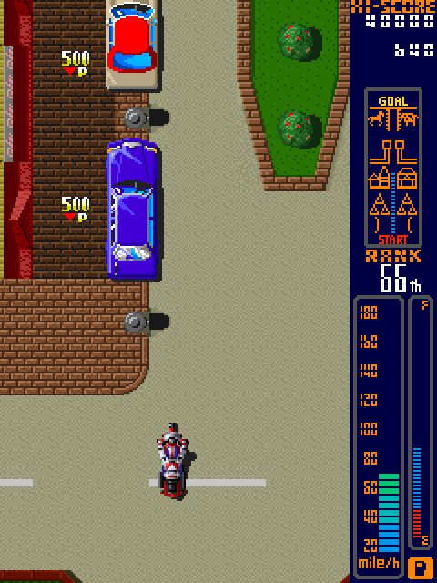
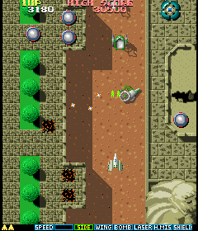


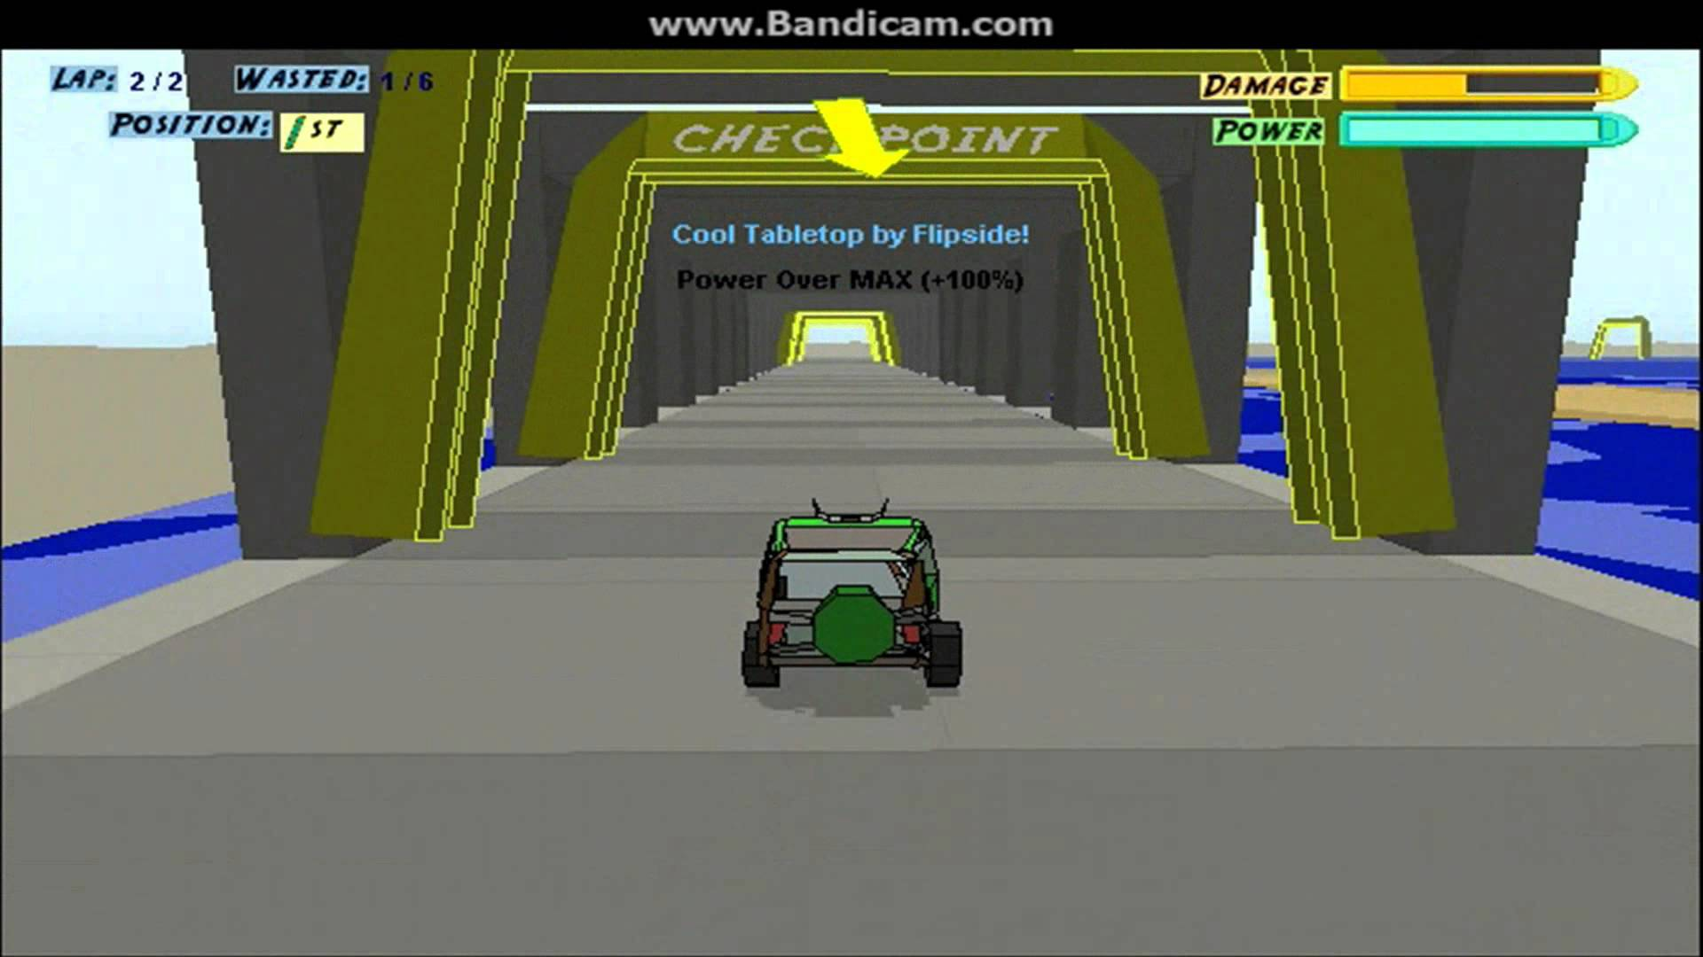
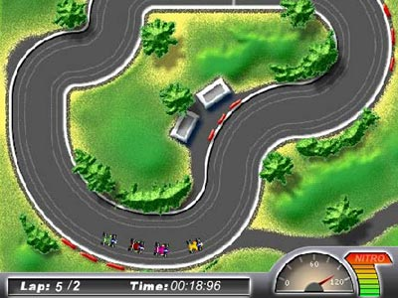
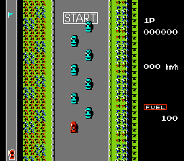
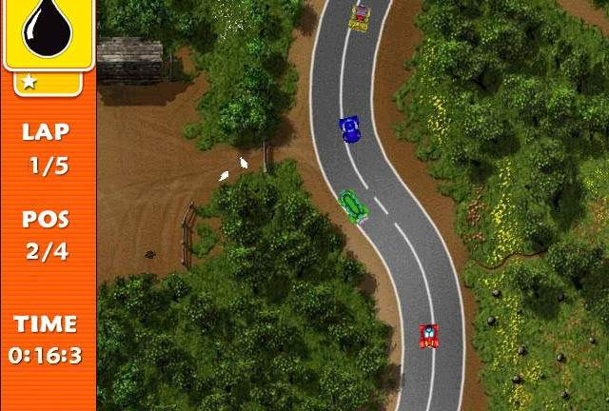
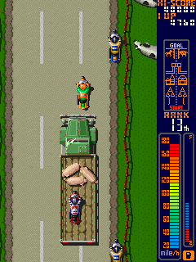
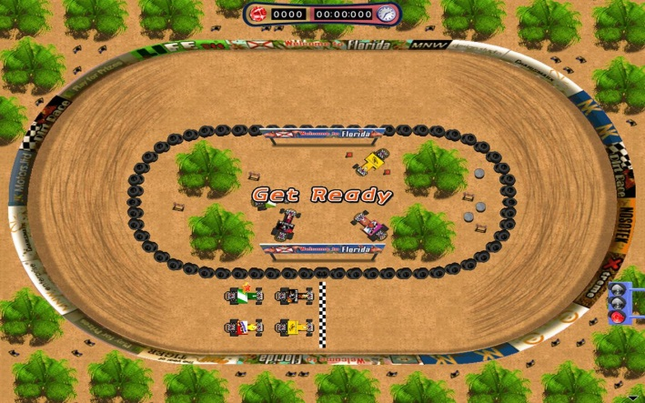
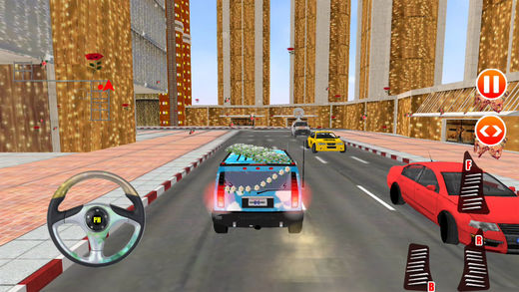
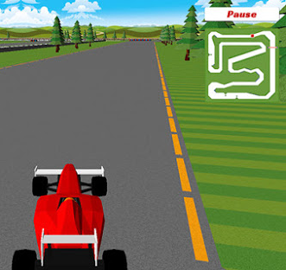
Mood board

Slide 3
Target Demographic/Audience
Male and Female gamers aged between 25-35 who play on their phones/tablets.
This is due to:
The average gamer age in the US being 30 in 2014 (Galarneau) and rising to 31 in 2015 (Lofgren)
The average gamer age in the UK is 35 (Galarneau)
Male and Female gamers ratio is very similar, ratio being 52 : 48 (Galarneau)
Mobile apps are more profitable. $28 billion in 2014 (Galarneau) and risen to $30.3 billion in 2015 (Lofgren)

Slide 4
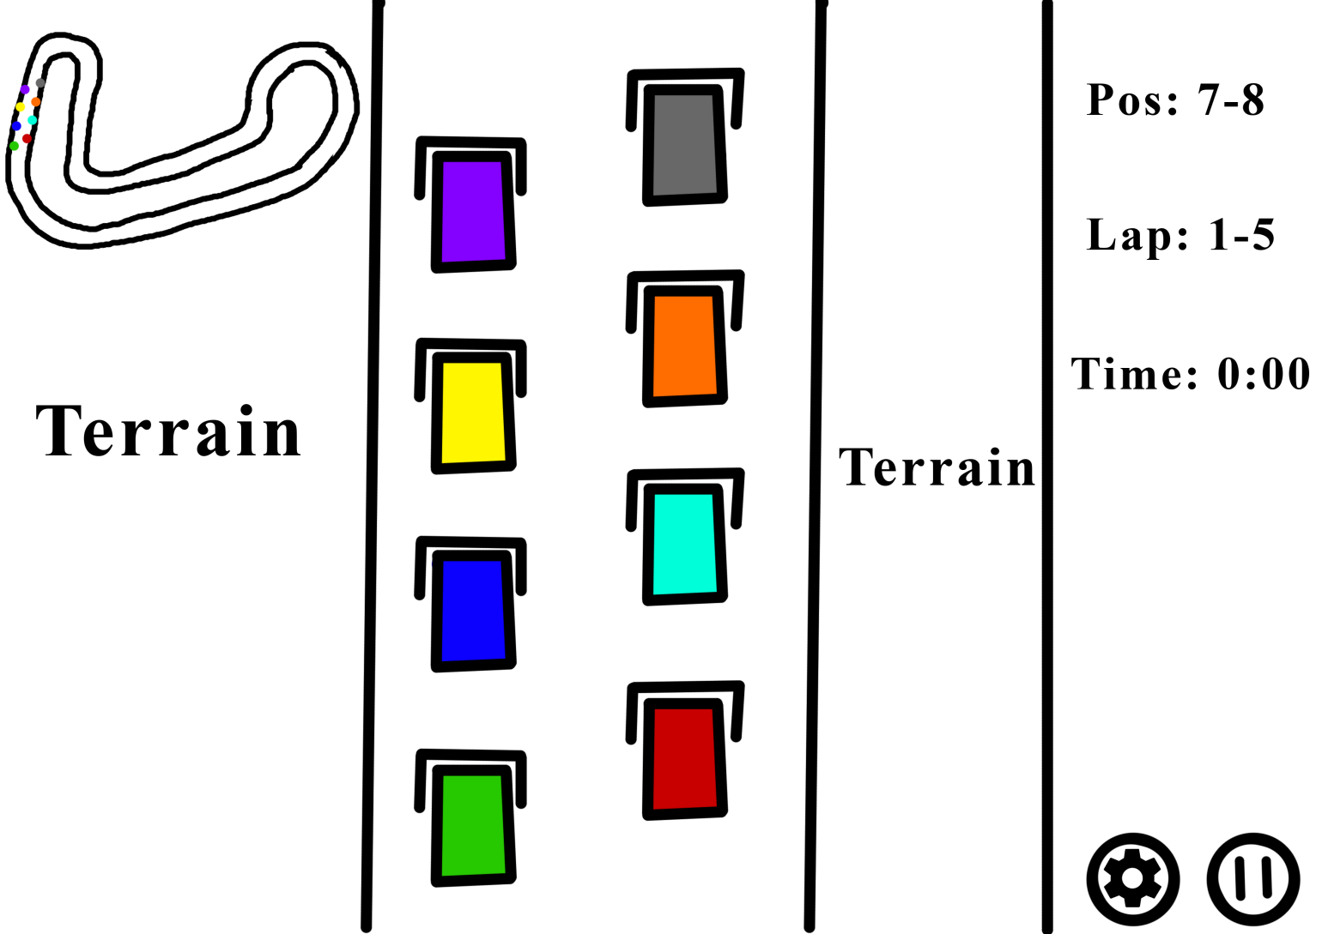
Concept art

Slide 5
References
Lazzaro, N. (2017). The 4 Keys 2 Fun | Nicole Lazzaro's Blog. [online] Nicolelazzaro.com. Available at: http://www.nicolelazzaro.com/the4-keys-to-fun/ [Accessed 8 Oct. 2017].
Galarneau, L. (2017). 2014 Global Gaming Stats: Who's Playing What, and Why? | Big Fish Blog. [online] Big Fish Games. Available at: http://www.bigfishgames.com/blog/2014-global-gaming-stats-whos-playing-what-and-why/ [Accessed 8 Oct. 2017].
Lofgren, K. (2017). 2015 Video Game Statistics & Trends Who’s Playing What & Why? | Big Fish Blog. [online] Big Fish Games. Available at: http://www.bigfishgames.com/blog/2015-global-video-game-stats-whos-playing-what-and-why/ [Accessed 8 Oct. 2017].

